Slide 1
MyIPA New Tool for Internal Communication Help file

Slide 2
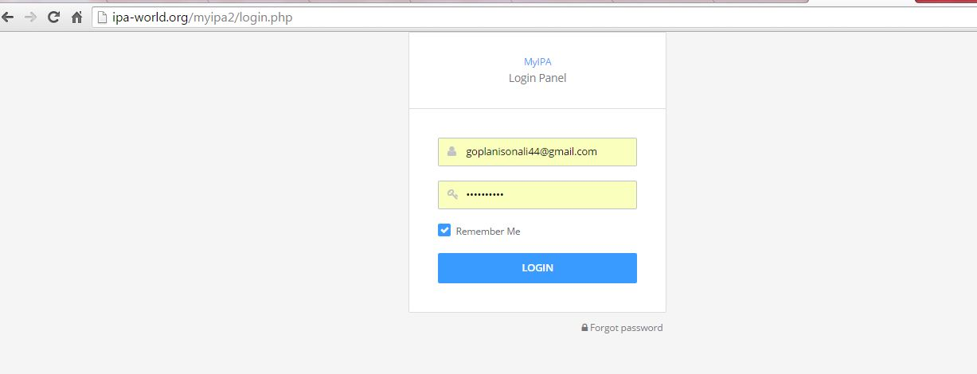
First login to MyIPA through website or Go to Link
www.ipa-world.org/myipa/
Enter your Login ID & Password ( sent to you)

Slide 3
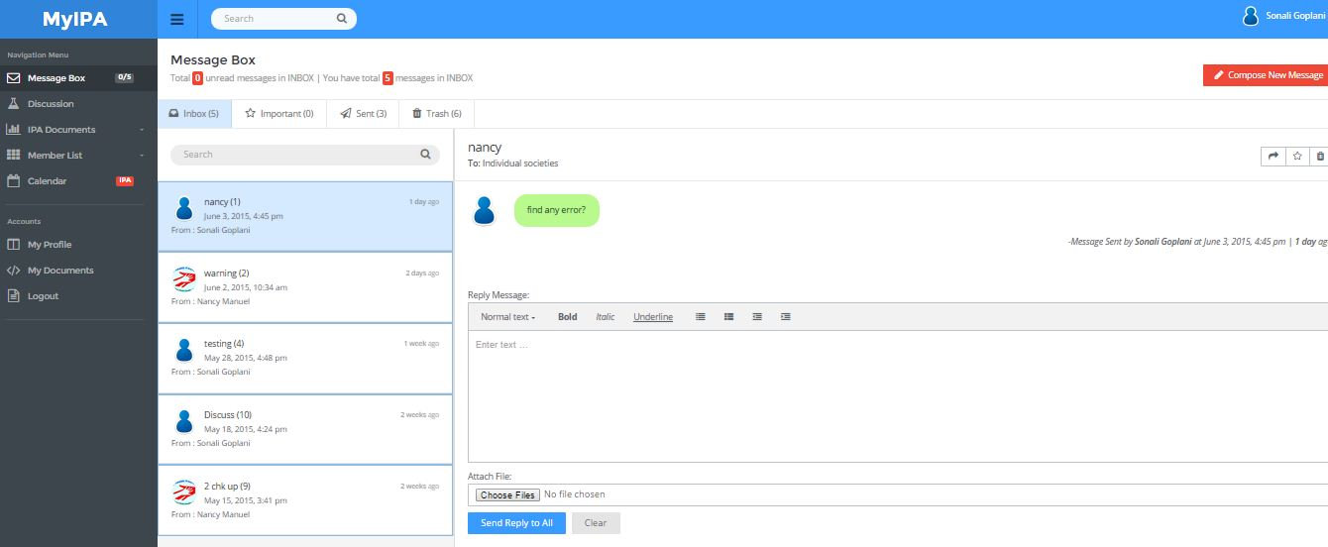
After Login, MyIPA dashboard will open with Message box as default

Slide 4
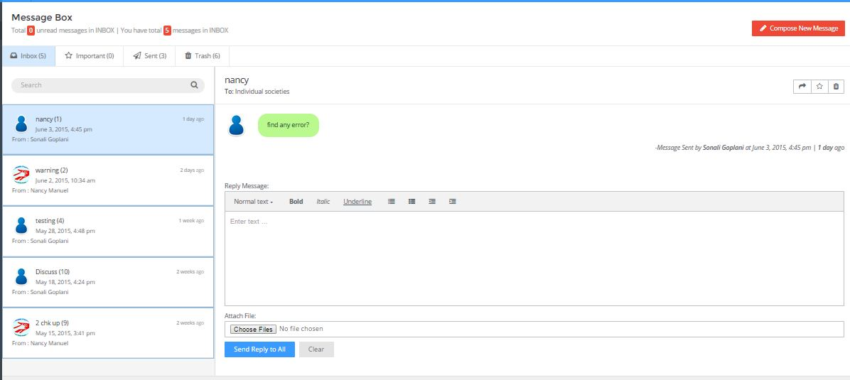
Mail (Message) Box Features
You can compose a new mail from here.
Inbox will show all received mails, important mails can be marked as
You can also review your sent mails & can send unimporant mail to Trash
You can reply from here.

Slide 5
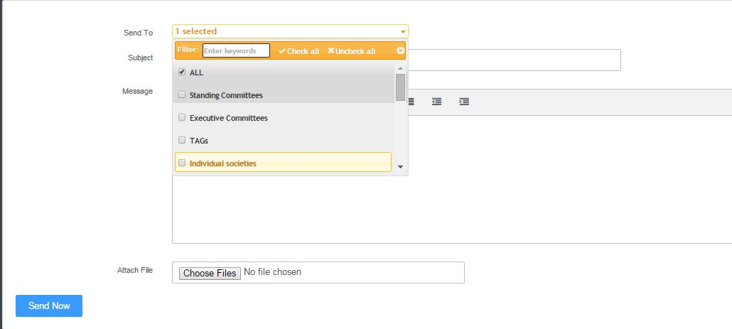
Compose New Mail (message)
While composing a new mail (message), you can select the committees to send the mails

Slide 6
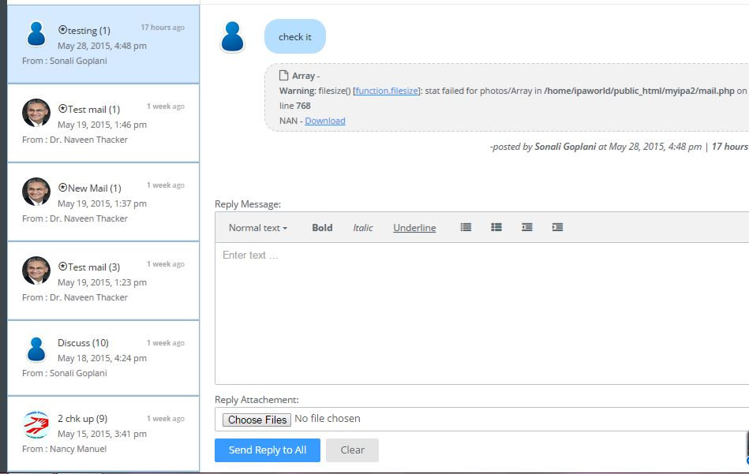
Attach Documents to mail (message)
* Marked mails are unread mails. Once you open this mail * will disappear automatically.
You can attach files in your reply message.

Slide 7
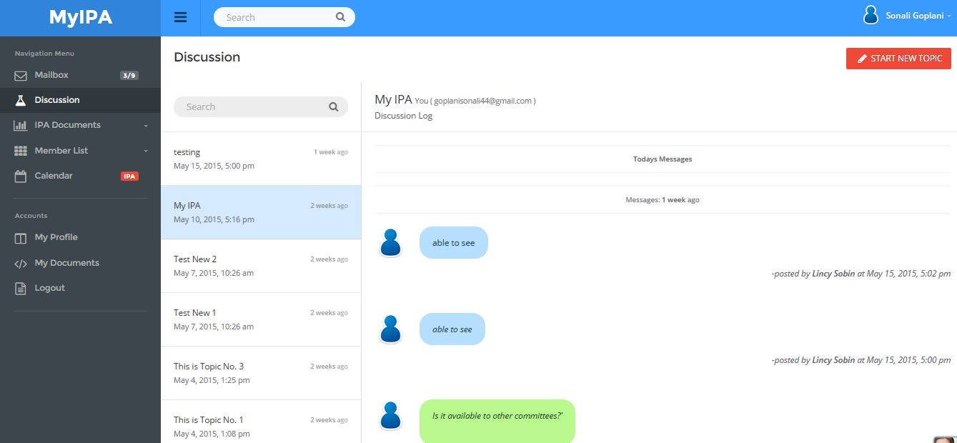
Discussion Panel & it’s Features
You can initiate a new discussion topic from here.
You can view all comments & discussions threads here.

Slide 8
Continue… Discussion Panel
You can start new discuss topic only with your committee members
If you want to start new discussion topic with other committees, please contact admin.
You can enter your comment here & post it

Slide 9
IPA Documents
In IPA Documents, you can view 2 types of Docs. Common Docs are visible to all.
Committee Docs are visible to only committee members
IPA Documents
Common Docs
Committee Docs

Slide 10
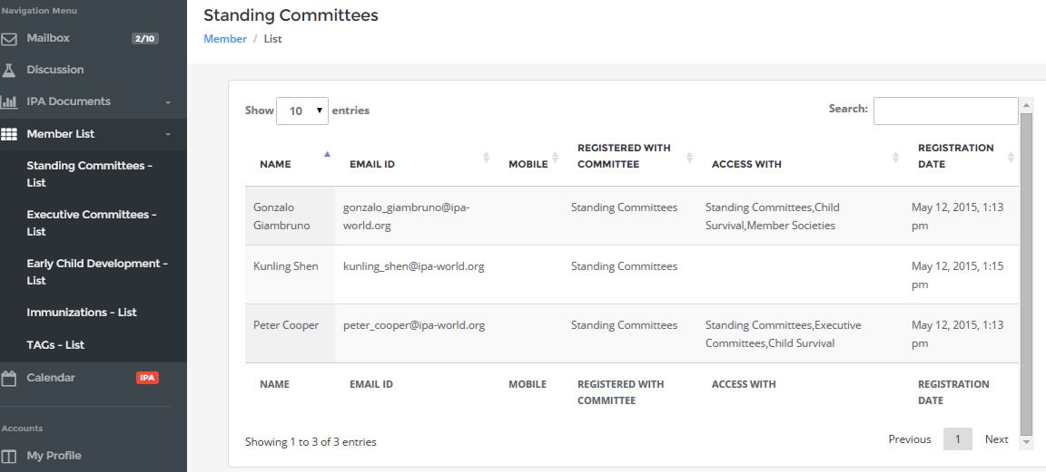
Member List
You can view member list of committees here .

Slide 11
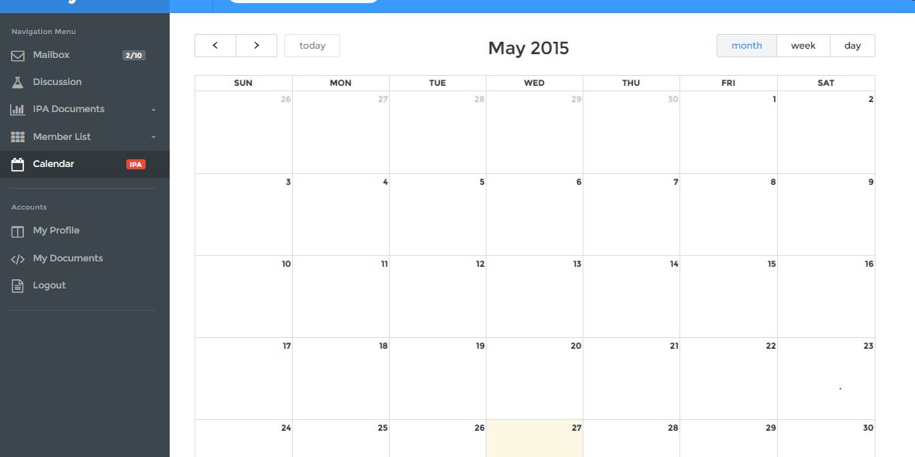
Calendar
All upcoming Internal IPA meetings posted by Admin will be displayed here.

Slide 12
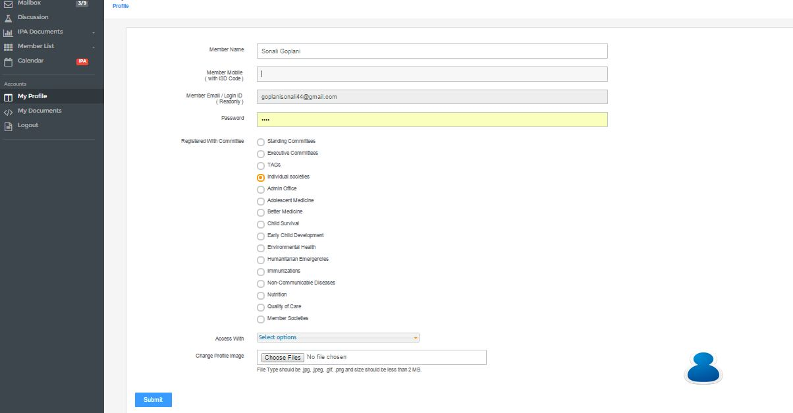
My Profile
My Profile
You can view & update your profile.(You cannot switch across committee by yourself, only admin can do it.)

Slide 13
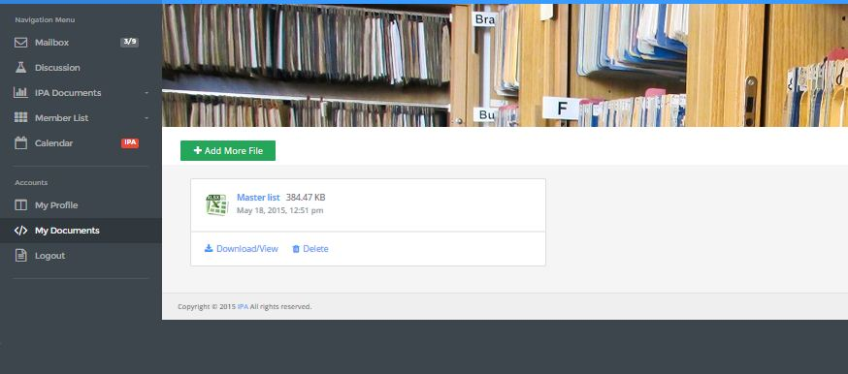
My Documents
My Documents
You can save your personal documents here visible to only you.

Slide 14
Logout
Do not forget to logout from here.

Slide 15
Quick menu
You can also use quick menu for Profile, Mailbox, Your personal Docs & Logout.

